Slide 1

Presenting your work to non-scientists
November 12, 2024

Slide 2
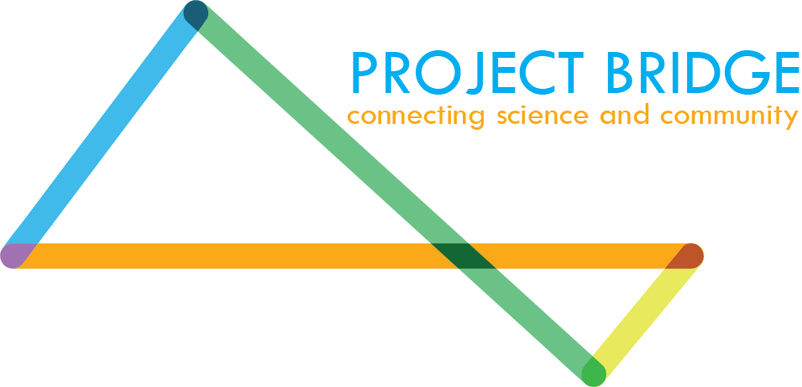
Presenting your work to non-scientists
Today’s Co-organizer:
Jade Young (jade.young@cuanschutz.edu)
Today’s Instructors:
Rachael Kostelecky & Natasia Paukovich
Volunteer signup: https://bit.ly/RLA-fall24volunteer
Today’s sponsor:

Slide 3
Thank you to today’s sponsor
The mission of Project Bridge is to foster public interest in primary science research. As scientists, we often find it difficult to express the excitement and importance of our work to our non-science family and friends. This communication barrier is also reflected in the current dour funding climate for primary research projects. As such, we believe that conscious efforts must be made to create new advocates for science research. Project Bridge holds workshops for scientists to strengthen communication skills. We also utilize a grassroots approach to address these issues through our multiple community events. This increased interaction between researchers and their community will increase the appreciation and understanding of the importance of scientific research. Look out for our podcast, The Science Bridge, releasing January 2025!
Notes:
Gong shows, K-12 outreach, STEM Poster day at the capital.

Slide 4

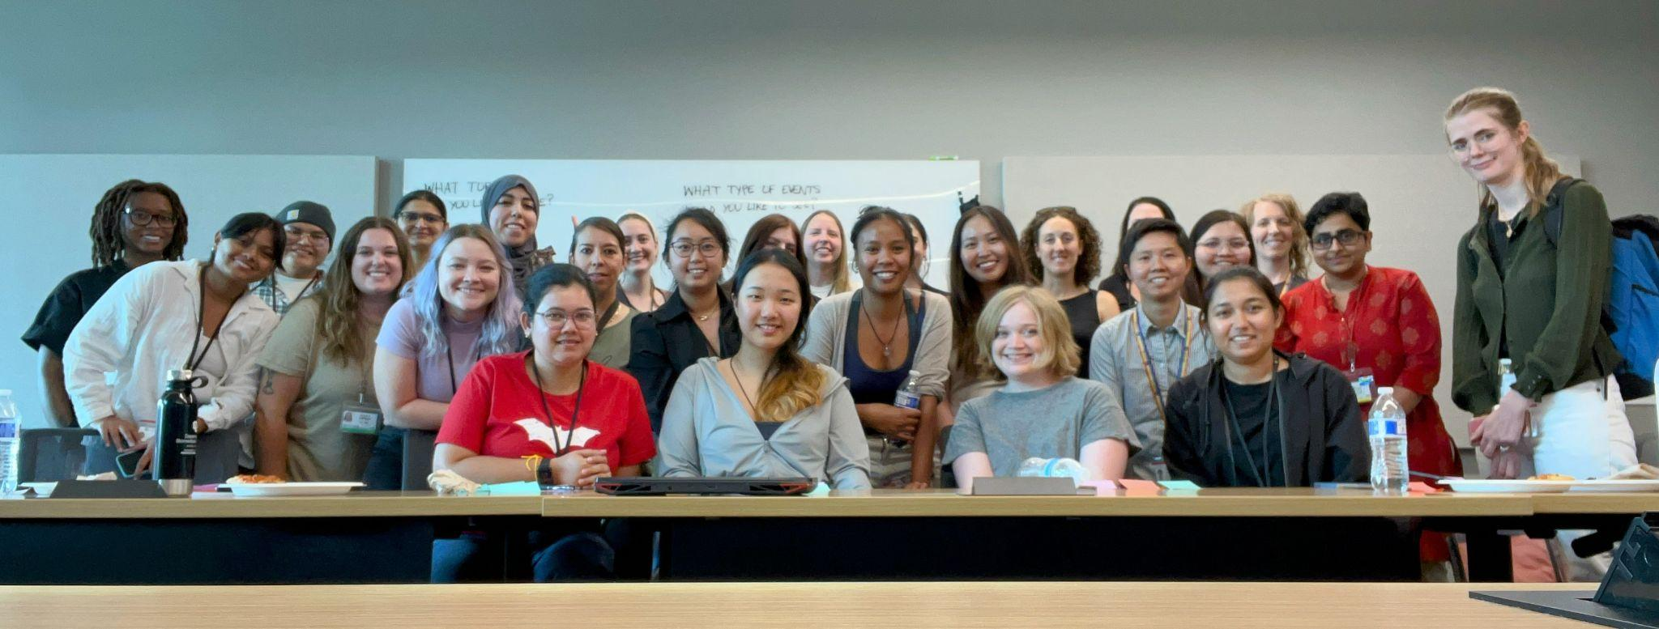
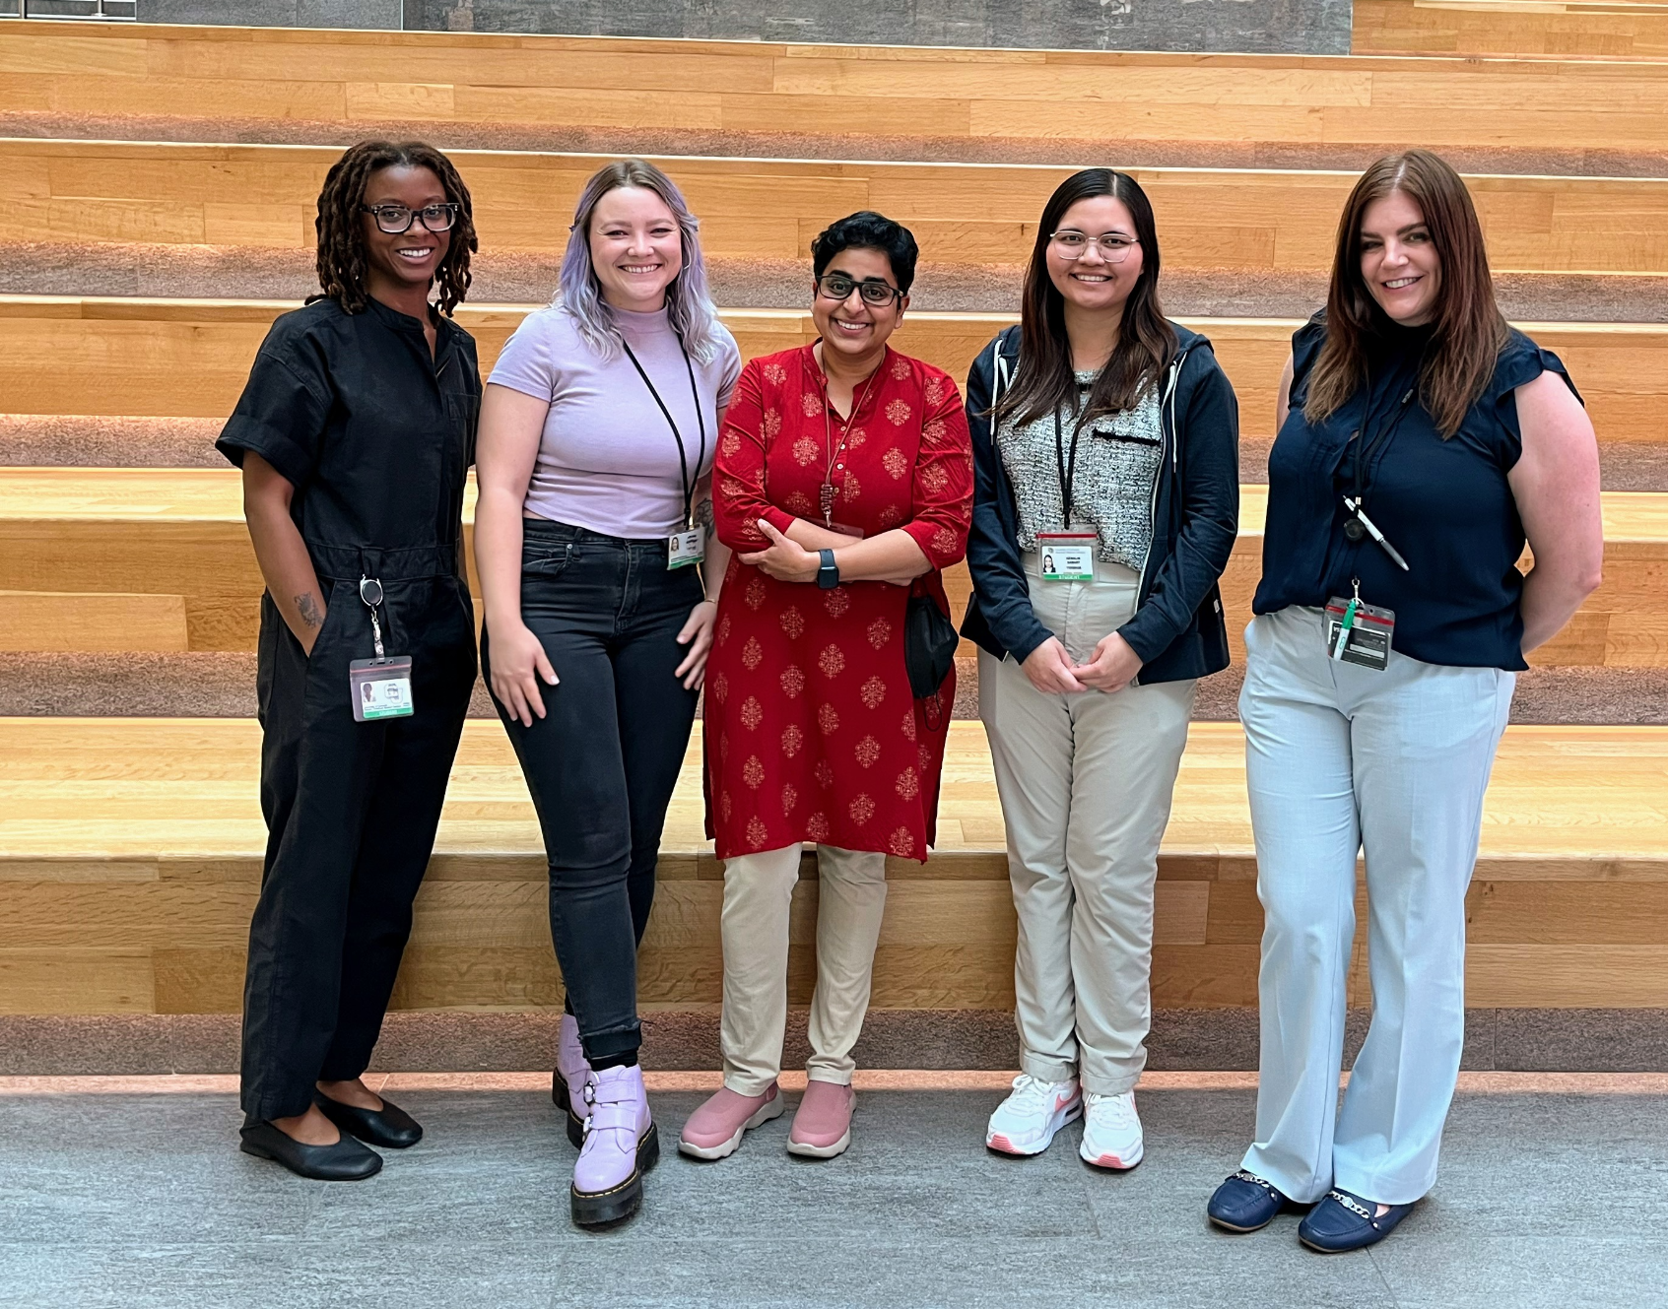
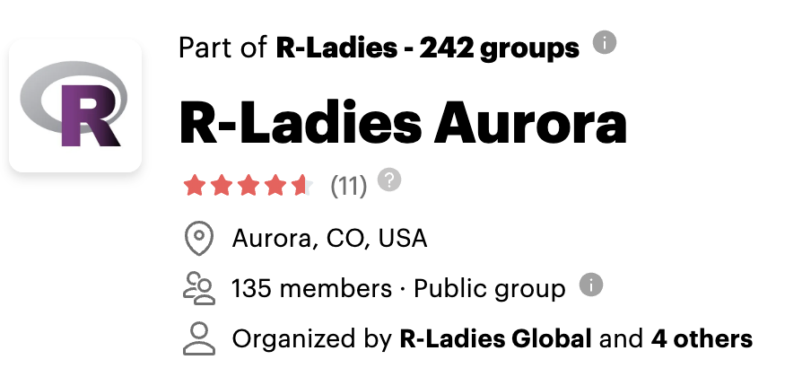
Who We R!?
R-Ladies Kick-off Event on Jul 25, 2024
RLA Co-organizer team: Jade, Keenan, Janani, Kewalin, Stacey (left to right)

Slide 5
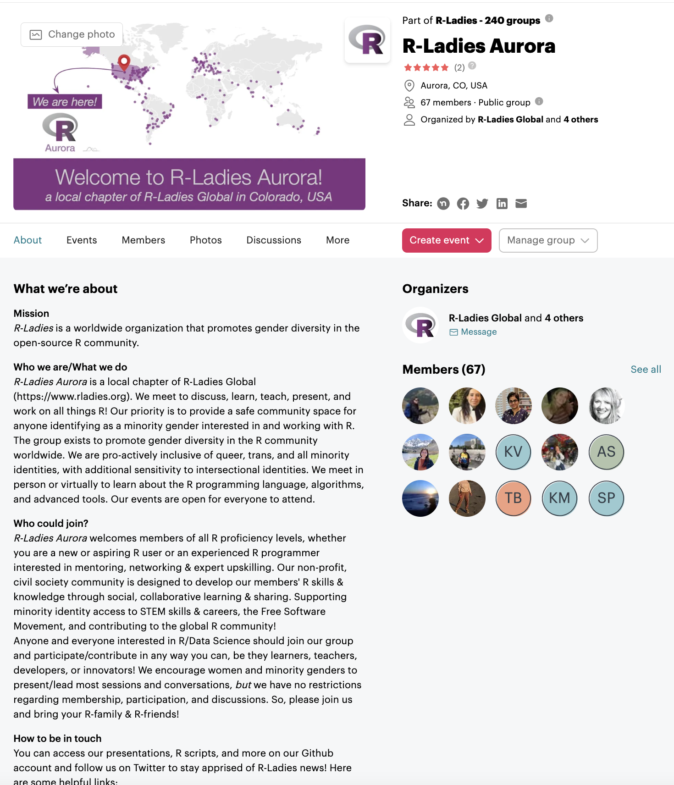

New Members?
X
137+ members and counting!
1. Join us, RSVP for events on Meetup
https://www.meetup.com/rladies-aurora/
2. Join our discussion forum on Discord
https://bit.ly/RLA-discord

Slide 6


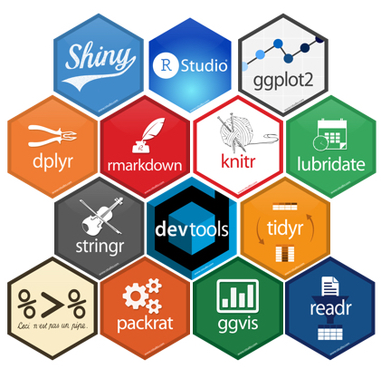

Upcoming Workshops
Fall’ 24 R-Ladies Aurora Series:
Intro to R Functions
DataViz 2.0
R Package Development
Presenting to Non-Scientific Audiences
Python in R

Slide 7
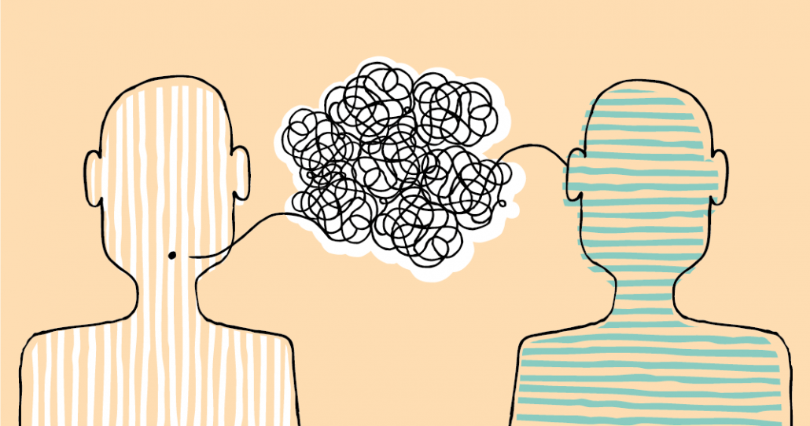
Today! Nov 11, 2024
TOPICS
Presenting to non-scientific audiences
Ping us on Discord with any Questions
https://allea.org/massimiano-bucchi-science-communication/

Slide 8
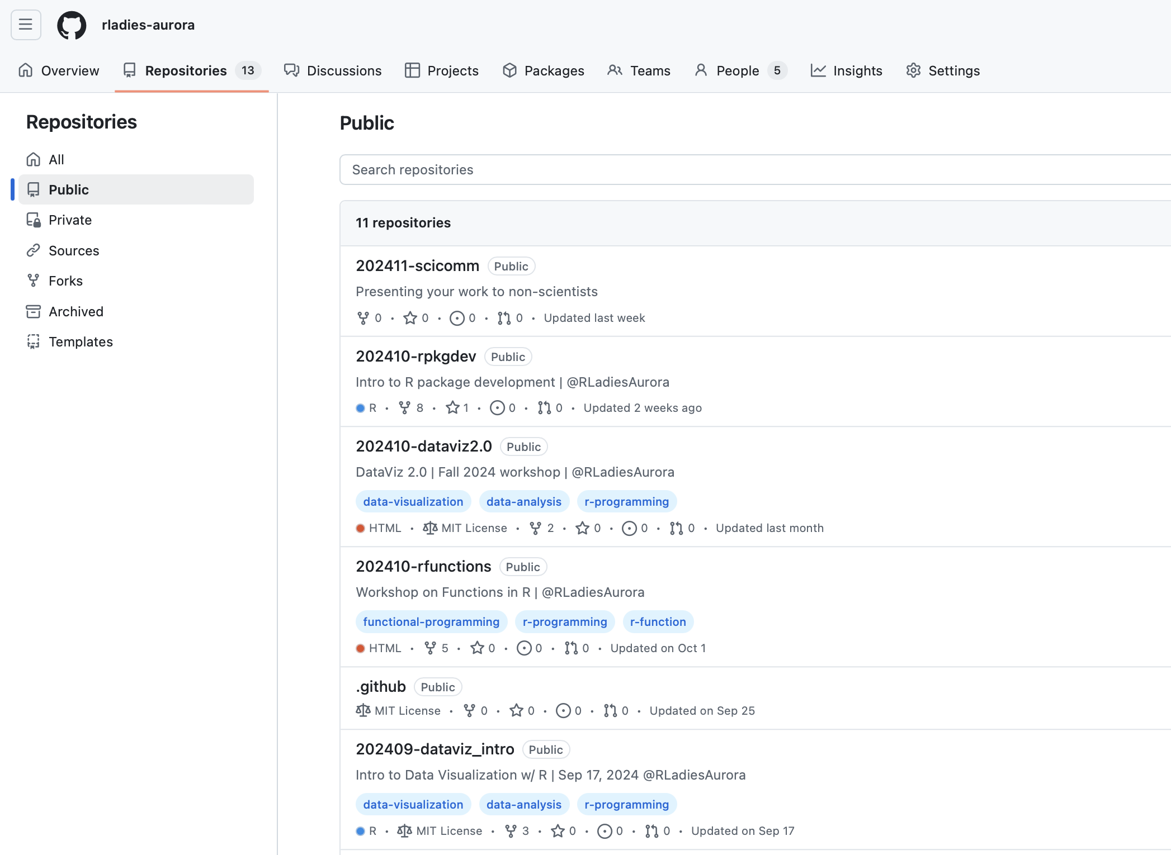
Presentation Materials
https://github.com/rladies-aurora/202411-scicomm

Slide 9

Intro | Meet & Greet
Pizza + Sign-up
Introduce yourself to your neighbor
Who you are | Name, affiliation

Slide 10


Communicating your science at holiday Dinners
Project Bridge x R-Ladies
November 12, 2024

Slide 11
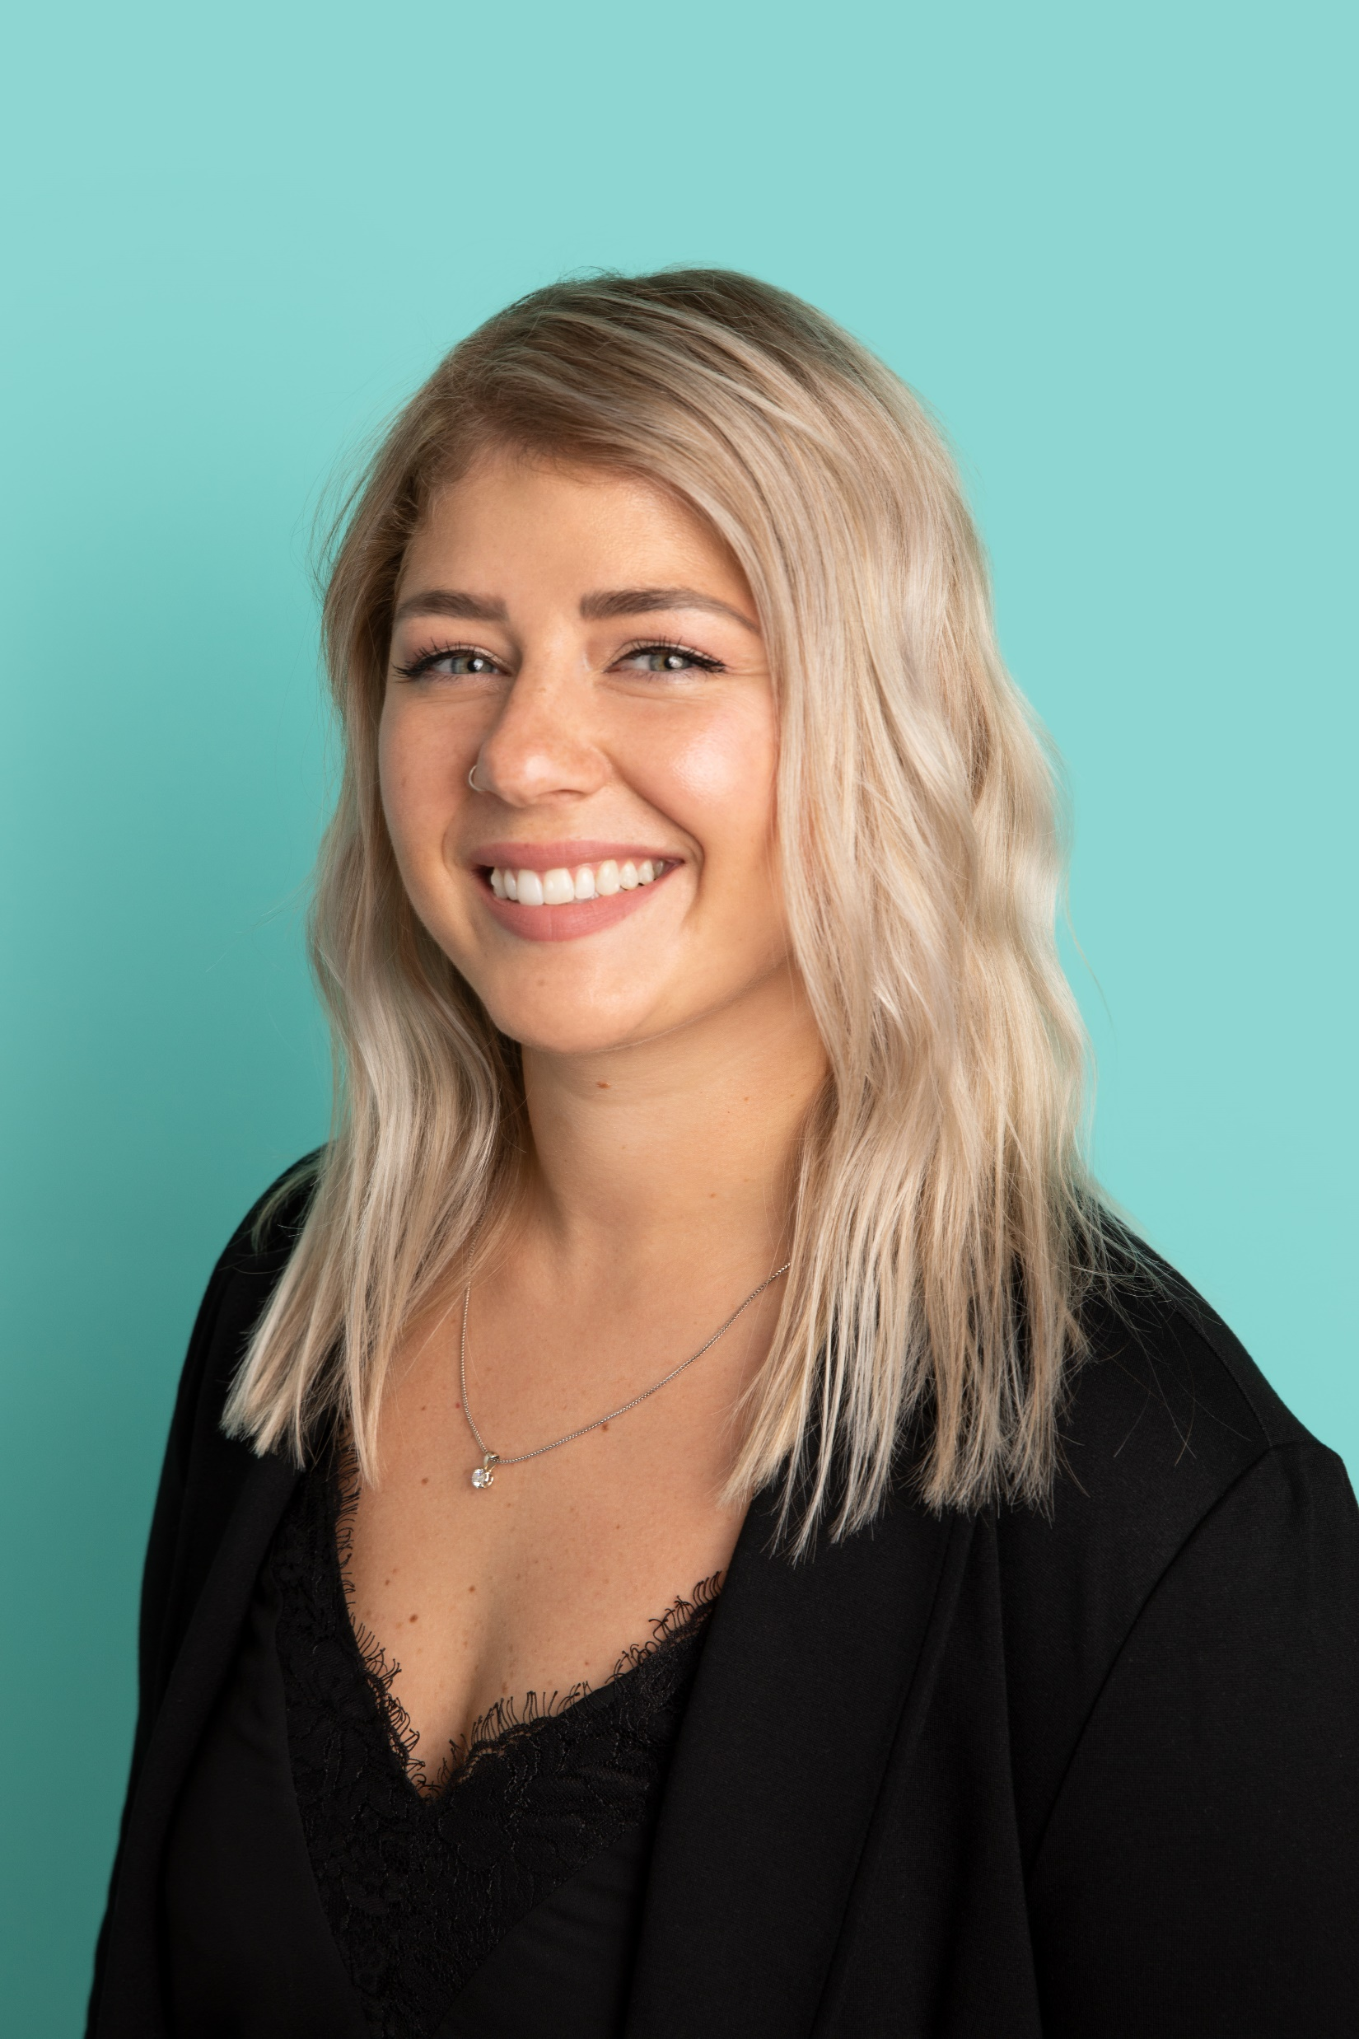
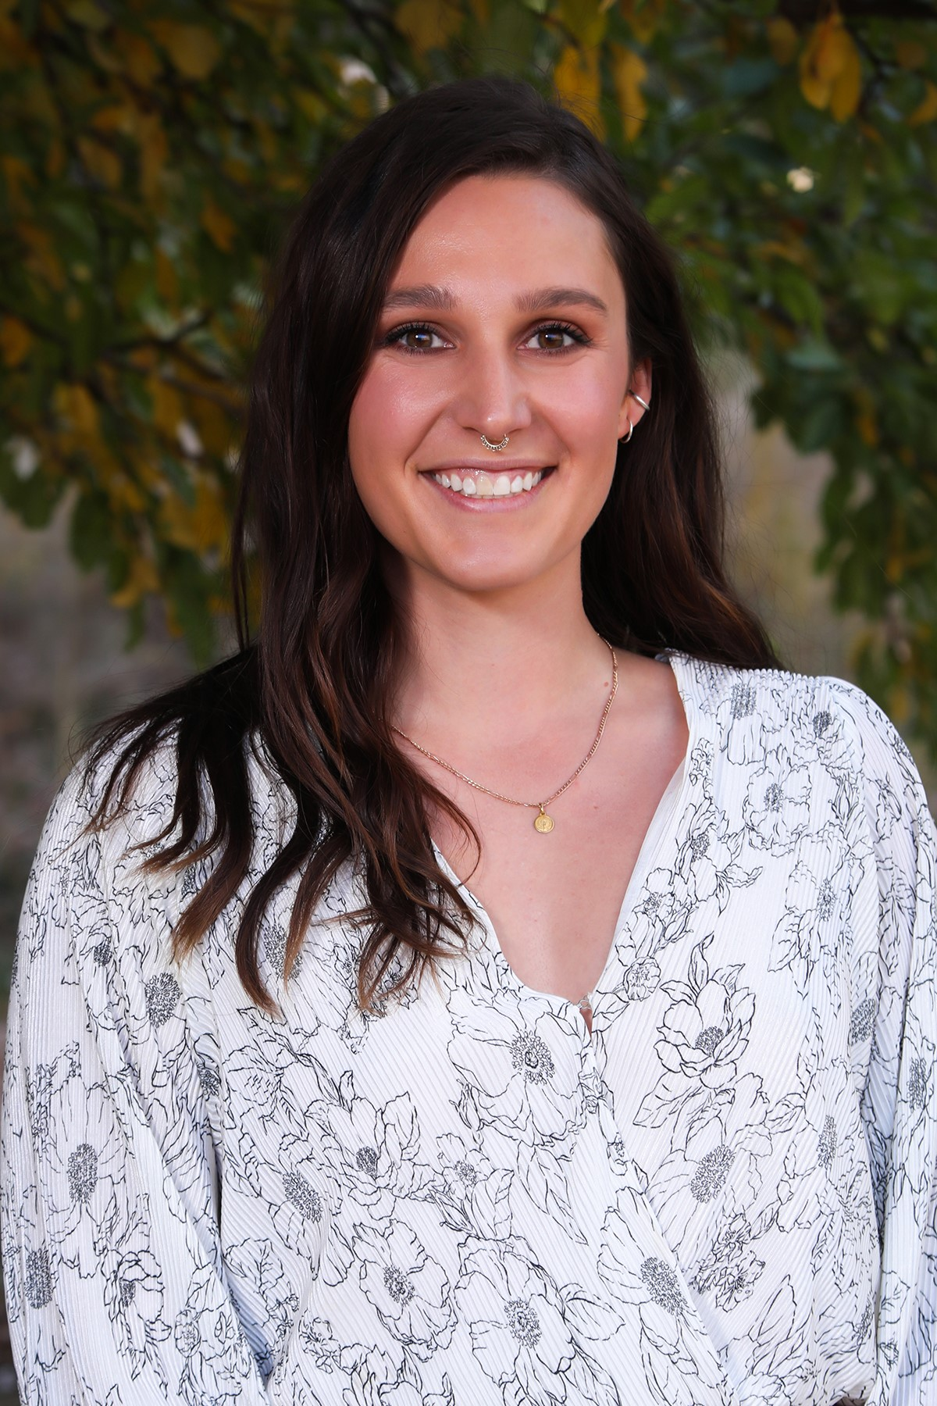
Rachael Natasia
3rd year MOLB student
van Dyk lab
Studies viruses
6th year MOLB student
Vögeli lab
Studies protein structure and function

Slide 12
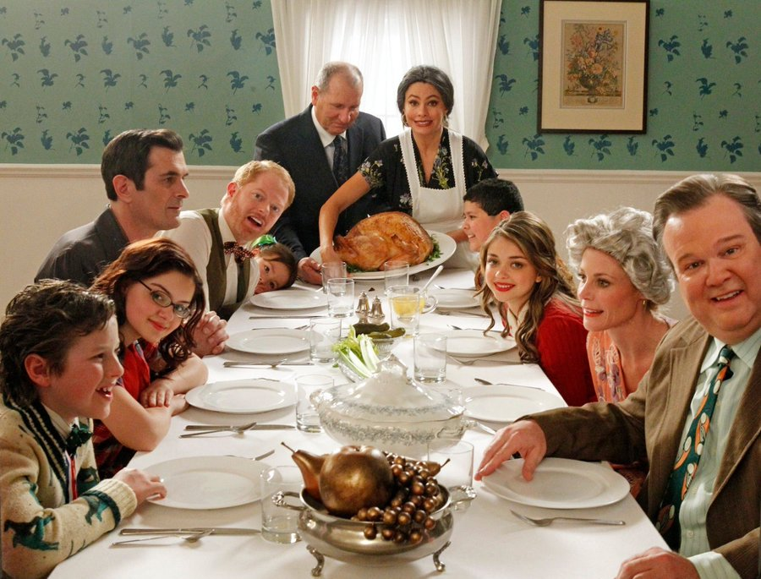
Tips and tricks
Who is your “audience”?
Notes:
1. Are you talking to adults? High school students? Children? Tailor your conversation based on what they might already know.

Slide 13

Tips and tricks
Who is your “audience”?
Use clear and simple language
Notes:
2. Try to use analogies and metaphors.

Slide 14
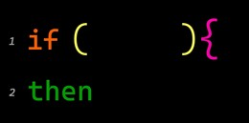
Tips and tricks
Who is your “audience”?
Use clear and simple language
Why does your research matter?
Notes:
3. If your research was successful, what is the potential big picture impact? Explain this in a way that is simple, and that your audience can relate to or understand.

Slide 15
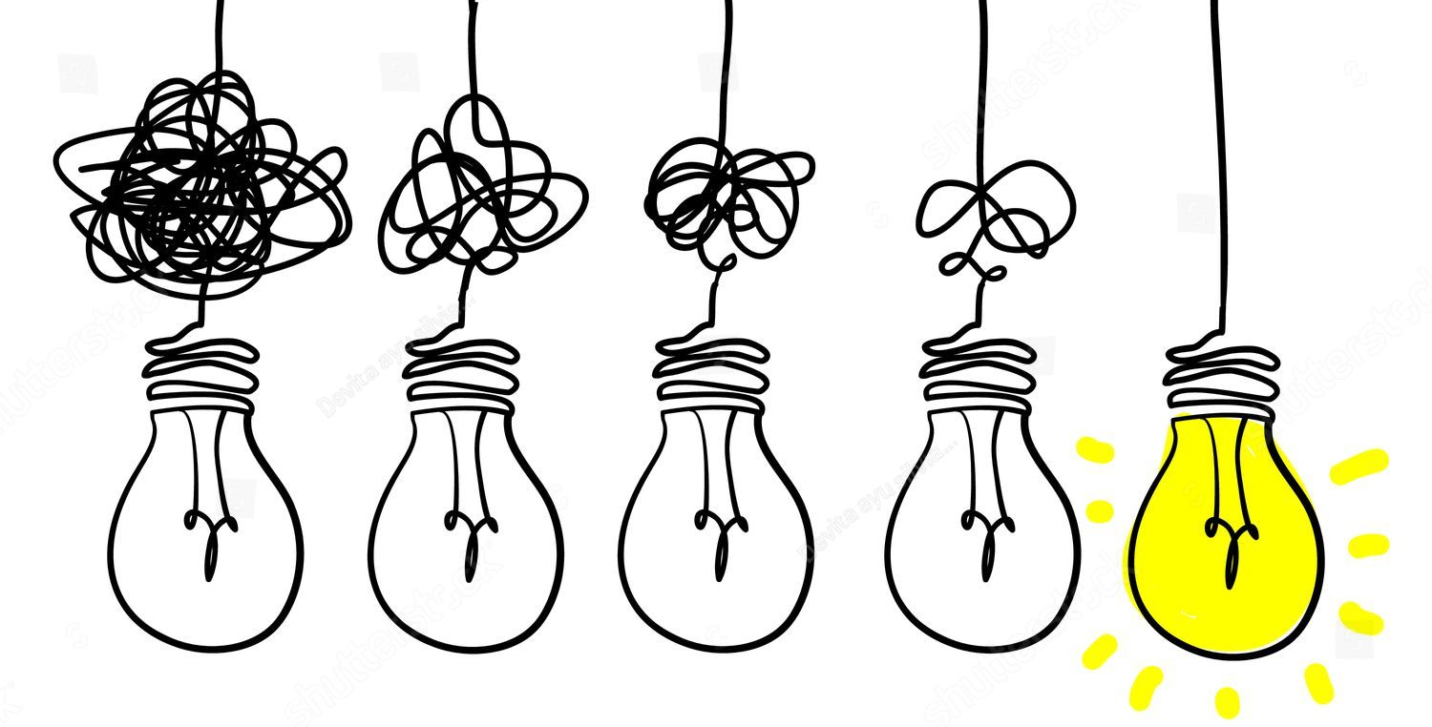
Tips and tricks
Who is your “audience”?
Use clear and simple language
Why does your research matter?
Make it a conversation
Notes:
4. Allow people to ask you questions. This is a gauge to see if they actually understand what you are explaining, or it can be used as a way to pivot and try to explain where the misunderstanding is coming from

Slide 16
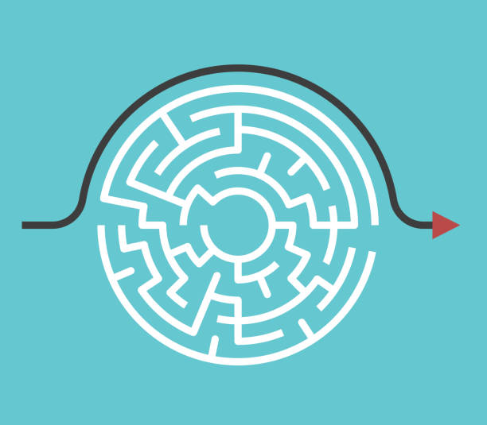
Tips and tricks
Who is your “audience”?
Use clear and simple language
Why does your research matter?
Make it a conversation
Less is more
Notes:
5. Focus on the big picture. It is difficult to explain what you do in great detail without jargon, start with a 10,000 foot view. What are the most important aspects or highlights? Keep it brief and fun.

Slide 17
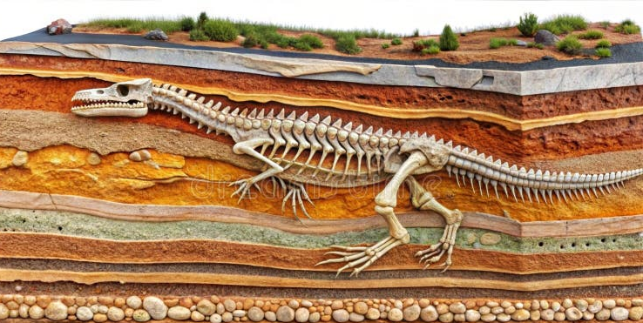
Tips and tricks
Who is your “audience”?
Use clear and simple language
Why does your research matter?
Make it a conversation
Less is more
Make adjustments
Notes:
6. If they seem to really be interested, dive a little deeper. It is like digging a hole.

Slide 18
Rachael’s Research
Gammaherpesviruses are DNA tumor viruses which include Epstein-Barr virus and Kaposi’s Sarcoma Associated herpesvirus. Virus infection originates at mucosal surfaces, followed by infection of macrophages, ending in B cells where the virus becomes latent. Within macrophages, the virus can exhibit both lytic and latent infection, but it is unclear how this is possible and what regulates this infection decision fate. I hypothesize that type I and type II interferon signaling synergistically enforces and maintains latent infection, respectively.
Notes:
Jargon

Slide 19
Rachael’s Research
Gammaherpesviruses are DNA tumor viruses which include Epstein-Barr virus and Kaposi’s Sarcoma Associated herpesvirus. Virus infection originates at mucosal surfaces, followed by infection of macrophages, ending in B cells where the virus becomes latent. Within macrophages, the virus can exhibit both lytic and latent infection, but it is unclear how this is possible and what regulates this infection decision fate. I hypothesize that type I and type II interferon signaling synergistically enforces and maintains latent infection, respectively.
Notes:
Flaws

Slide 20
Rachael’s Research
There are 3 types of herpesviruses. The most well-known is the family of herpesvirus that causes chicken pox, shingles, and oral and genital herpes. The second kind is not as well known but can cause an illness in children caused roseola. The third family is what I study; it can cause cancer. The virus first infects the body through surfaces like the mouth or nose, then spreads to a special kind of immune system cell called macrophages, and finally ends up in another type of immune cell called B cells, where the virus goes to sleep. In macrophages, the virus can either make more copies of itself or go to sleep, but we don’t understand how it makes this choice. I believe that the immune system sends out specific signals that helps the virus decide to stay asleep.
Notes:
Corrected

Slide 21
Rachael’s Research
There are 3 types of herpesviruses, the most well-known is the family of herpesvirus that causes chicken pox, shingles, and oral and genital herpes. The second kind is not as well known but can cause an illness in children caused roseola. The third family is what I study; they can cause cancer. When someone gets infected with any of these types of herpesviruses, the virus gets inside of your cells and makes more copies of itself. Eventually, your immune system will control this infection, and the virus will “go to sleep” inside of your cells. However, when you have a weakened immune system, this virus can wake back up and start making copies of itself again. The difference between these virus families is the type of cell in your body that it goes to sleep in. I am trying to figure out what specific part of the immune system causes the switch between the virus going to sleep and waking up, and if we can control this.
Notes:
Corrected

Slide 22
Natasia’s Research
Kinesins are a class of anterograde cellular transporters that move cargo from the nucleus to the cell periphery. This process is critical in neurons, where the asymmetric shape and long axons hinder the diffusion of essential cellular components to the synapse, where they are needed for neuron firing and synapse formation. Proper kinesin function is crucial, as misallocation of cargo is associated with neurological disorders and neurodegenerative diseases such as schizophrenia and Alzheimer’s. Kinesins have to be spatiotemporally regulated and I study a protein called Olduvai which binds to the motor domains of kinesins and I hypothesize that the binding interaction alters kinesin procession along microtubules.
Notes:
Jargon

Slide 23
Natasia’s Research
Kinesins are a class of anterograde cellular transporters that move cargo from the nucleus to the cell periphery by walking along microtubules. This process is critical in neurons, where the asymmetric shape and long axons hinder the diffusion of cellular components to the synapse, where they are needed for neuron firing and synapse formation. Proper kinesin function is crucial, as misallocation of cargo is associated with neurological disorders and neurodegenerative diseases such as schizophrenia and Alzheimer’s. Kinesins have to be spatiotemporally regulated and I study a protein called Olduvai which binds to the motor domains of kinesins and I hypothesize that the binding interaction alters kinesin procession along microtubules.
Notes:
Jargon

Slide 24
Natasia’s Research
Kinesins are a type of protein in our cells act as a train. These kinesin trains use molecular tracks called microtubules to get from one place to another. Using these tracks the kinesin trains move important cellular cargo from the center of the cell to the outer regions. This transport especially important in brain cells, called neurons. Neurons are irregularly shaped with the cell’s headquarters separated from the cell’s communication center by a long skinny pathway called the axon. It’s imperative that this cargo makes it to the communication center at the end of the axon because this is where neurons connect and communicate to one another. If this goes wrong it can lead to brain disorders like schizophrenia or Alzheimer's. These trains need to know where to go and when and they are often regulated by other proteins in the cell. I study one of these regulator proteins called Olduvai which attaches to the wheels of the train and I believe this changes how the trains move their cargo.
Notes:
Jargon

Slide 25
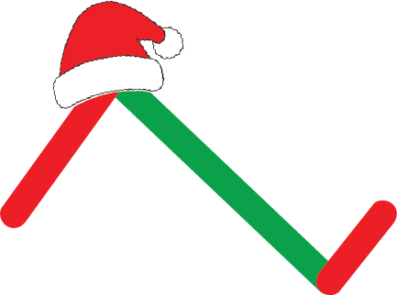
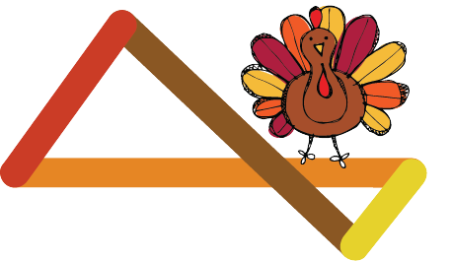

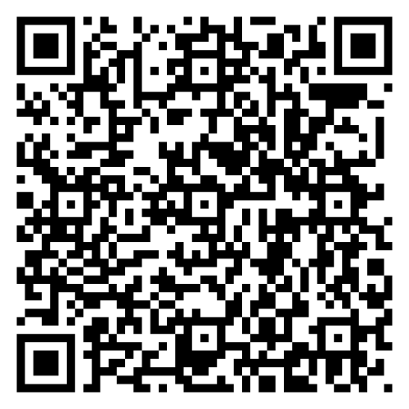

Thank you!!
Project Bridge Organization Website
Sign up for our email list!!
Project Bridge Colorado Website
Follow us on Instagram and X: @ProjBridgeCo
Notes:
Jargon

